Slide 1
Bureau of Transportation Statistics (BTS) Freight Data Program Updates Presented at Modeling Mobility
September 17, 2025
By Monique Stinson, Jingsi Shaw, Praveen Hettige, Stephanie Lawrence
USDOT Bureau of Transportation Statistics (BTS)
Notes:
US Department of Transportation (USDOT) Bureau of Transportation Statistics (BTS)
BTS produces both passenger and freight data products
Today’s focus: Freight data products used in modeling

Slide 2
BTS Freight Data Products
Origin-Destination (OD) Flows
Other Freight Data Products & Compilations
Commodity Flow Survey (CFS)
Freight Analysis Framework (FAF)
Freight Mobility Institute (FMI)
Port Performance
Transborder/Border Crossing
Aviation: T-100 Air Cargo
Geospatial layers: National Transportation Atlas Data (NTAD)
Vehicle Inventory and Use Survey (VIUS; with US Census)
Freight Logistics Optimization Workflow (FLOW; confidential)
Freight Transportation Services Index (TSI)
Transportation Satellite Accounts (TSA)
Supply Chain Indicators
Freight Facts & Figures
Transportation Statistics Annual Report (TSAR) Freight Chapter

Slide 3
2022 Commodity Flow Survey (CFS): A Survey of ~165,000 U.S. Shippers
The only publicly available data source for highway freight, providing comprehensive, multimodal data of national freight flows in the U.S.
Sampling frame: mining, manufacturing, wholesale, and select retail/service industries that ship
Uses include goods movement trends analysis & forecasting; guiding investment decisions on transportation infrastructure
Main data source for the Freight Analysis Framework (FAF), but unlike FAF, contains Hazmat, temperature control, & NAICS detail
~80M shipment records in 2022
Products:
Data Tables: aggregate data on shipment attributes (e.g., value, weight, distance) by origin, destination, mode
*Public Use File: shipment-level data
*Subarea Estimates: experimental data product with additional geographic granularity (329 subareas vs. 132 zones in 2017)
Subareas for Iowa and Illinois
*Release expected by November 2025
https://www.bts.gov/cfs

Slide 4
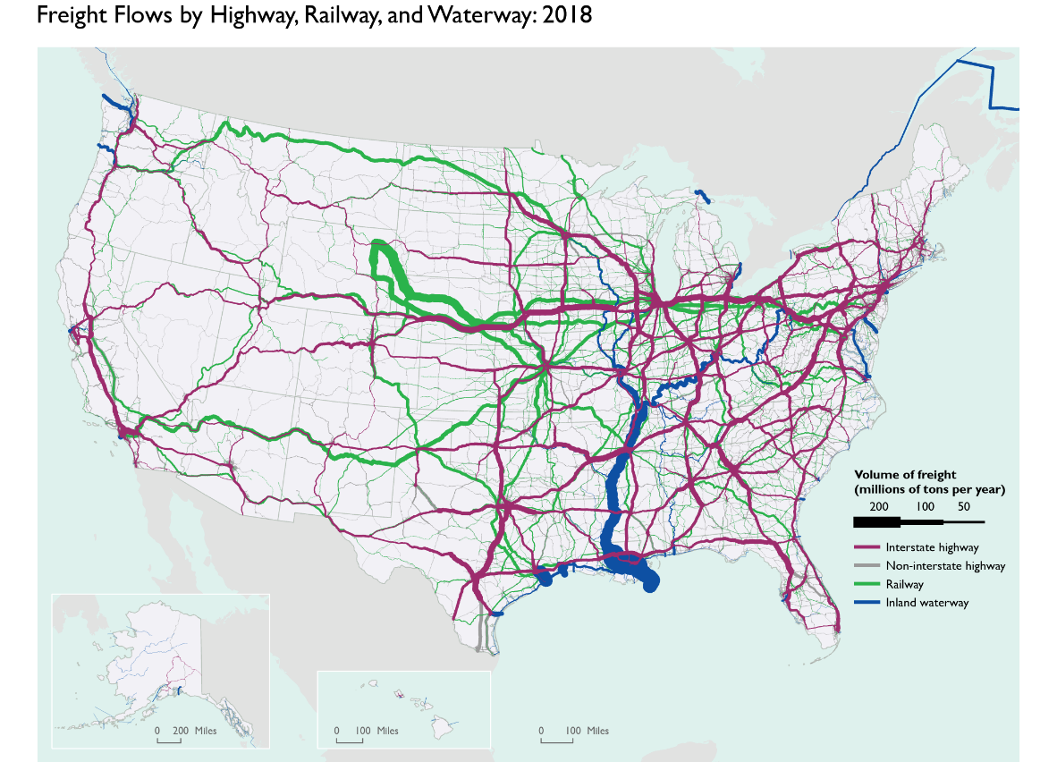
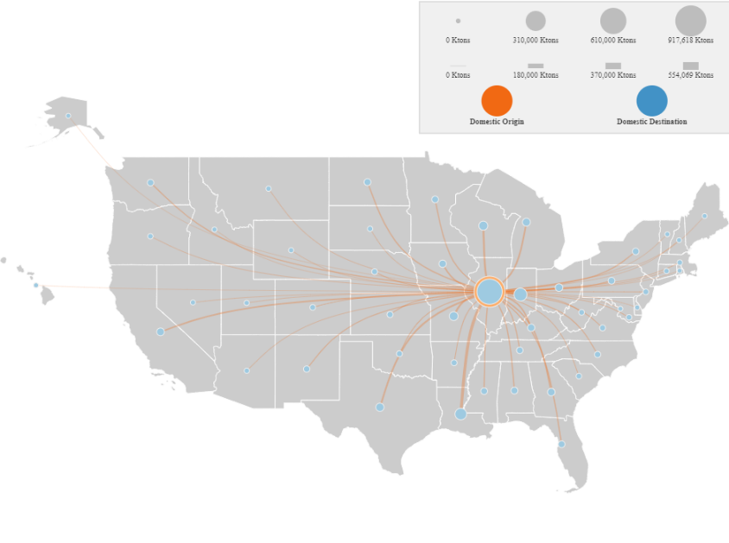
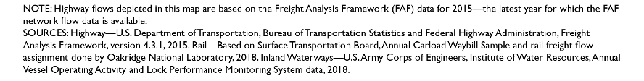
The Freight Analysis Framework (FAF) Provides Estimates of US Freight Flows
Product 1: Database of flows by Origin (O), Destination (D), 42 Commodities, *8 Modes
Includes foreign O/D and mode (if applicable)
Volumes: tons, value, and ton-miles
Product 2: Network flows** by Truck, Rail and Water (e.g., estimated volumes on interstates)
Origin | Destin-ation | SCTG2 | Tons | Value | Ton-miles | Domestic Mode | Foreign Mode
Wyoming | Chicago region | Coal | xx | xx | xx | xx | xx
… | … | … | … | … | …
*Modes: Truck, Rail, Water, Air, Multiple Modes & Mail, Pipeline, Other/unknown, No domestic mode **Truck is assigned volumes; rail, water are currently provided by the Federal Railroad Administration and the US Army Corps of Engineers
FAF5 is developed by BTS in partnership with Federal Highway Administration (FHWA)

Slide 5
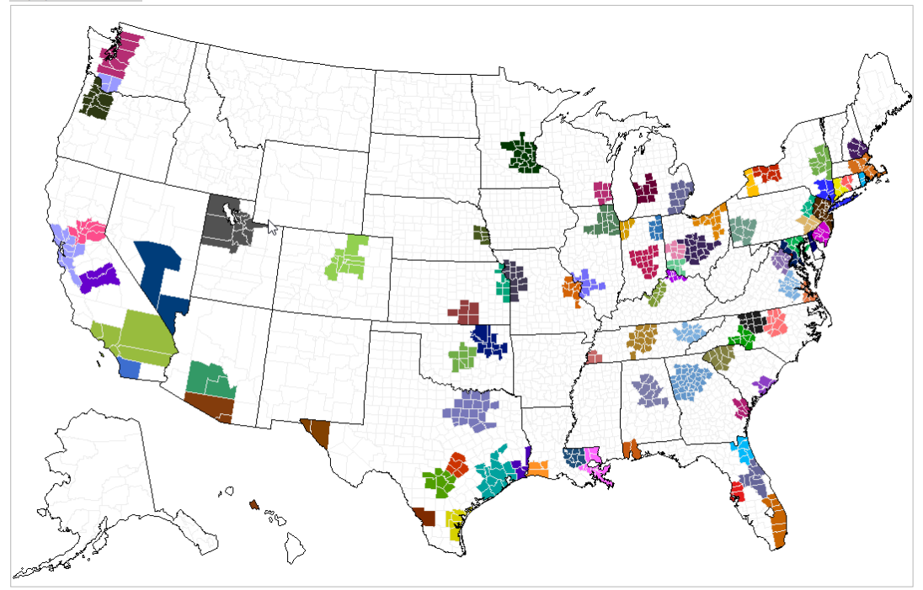
Experimental County-level OD Flows
Input data
Disaggregate FAF5.6.1 tons using three methods
Construct validation targets
Disaggregated FAF OD flows from 132 regions to 3,000+ counties
Approach: composite method with regression
Released January 5, 2025
3 county-level OD estimates (M1, M2, M3)
Validation targets
132 domestic regions
Develop 1 composite estimate using OLS:
Validation target = f(M1, M2, M3)
Constraints: Nonnegative tons; No Rail (Water) in counties with no facilities; County tons sum to FAF zone tons.
Performance analysis: Compare composite estimates to validation targets
https://www.bts.gov/faf/county

Slide 6

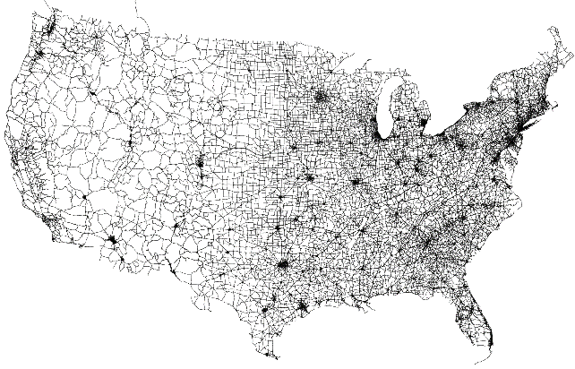








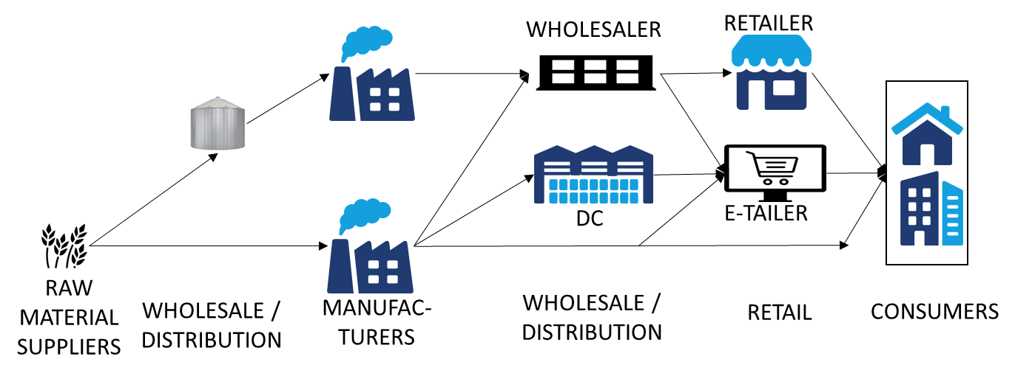



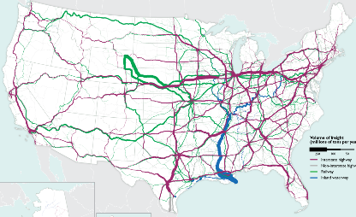

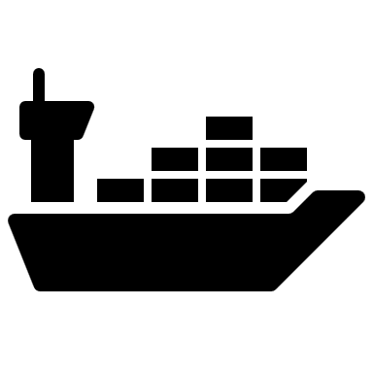

Forecast Modernization (Tentative)
LEGEND
Freight Transportation Demand
Freight Transportation Supply
Supply-Demand Interaction
FREIGHT TRANSPORTATION DEMAND
TRANSPORTATION & LOGISTICS PARTNERSHIPS
FREIGHT TRANSPORTATION FLOWS
Business population
(Need employment projections)
Split last-mile into pickup and delivery shares
Model mode choice and shipment size
Establishments
Freight generation (production & attraction)
PICKUP OR DELIVERY
FREIGHT TRANSPORTATION SUPPLY
Traffic assignments (unimodal & multimodal)
Shipping level-of-service: travel time (& variance), cost
Supplier selection → OD flows
LA
Chicago
+ VALIDATION

Slide 7
FAF6 Release Timeline (Tentative*)
Benchmark: Feb. 2026
County Level Ver. 1 (FAF5)
**PE 2024, AE 2023 (FAF5)
Forecast: Dec. 2026
Updated AE, PE for 2023-2025: mid to late 2026
←………………..→
2025 2026 2027
← CFS Products→
Updated Networks and Assignment
*depends on resources and data availability
**AE, PE: (Preliminary) Annual Estimates
Notes:
Highway assignment ~mid-2027; multimodal may be later

Slide 8
Some Reflections… and Questions to You
Opportunities
2022 CFS: richer detail (more shipments; more modes)
2021 VIUS: more up-to-date payload factors and SCTG 01 flows
FAF modernization: improved data sources, updated methods, and more quality checks
FAF forecast goals: sensitivity to modal levels-of-service; improved alignment with local socioeconomic growth
Challenges
2022 was a very unusual year, especially for waterborne freight → this shows up in the CFS. How can our annual estimates, projections, assignment, etc. handle this?
Tabulating 80M shipment records takes a long time
Ongoing gap: retail-based shipping (but we are looking into it)
Publicly available sources of long-range employment projections
We need your feedback on our modernization efforts.
What directions are valuable to you?
What improvements would further help your work?
Notes:
Mention SCTG revision underway

Slide 9
faf@dot.gov & BTS’ Ask-a-librarian

Slide 10
appendix

Slide 11
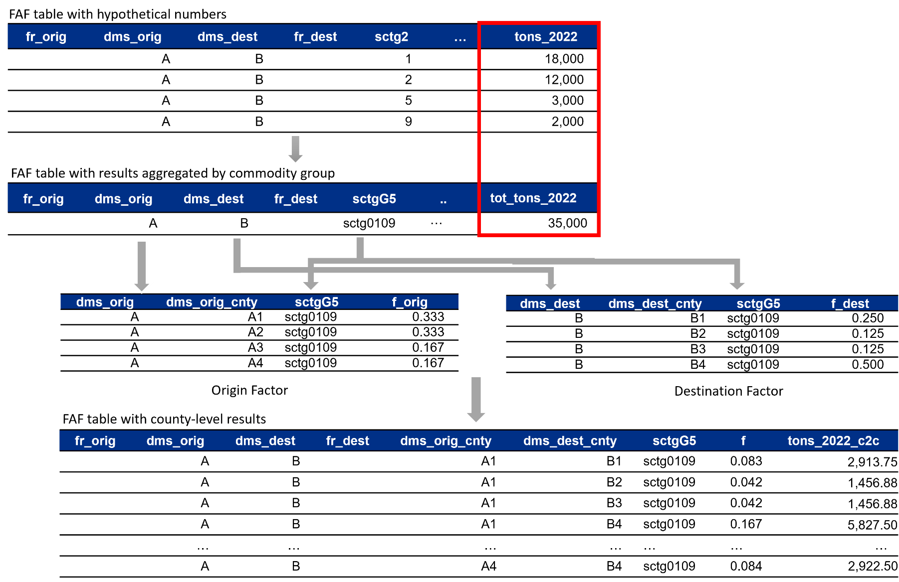
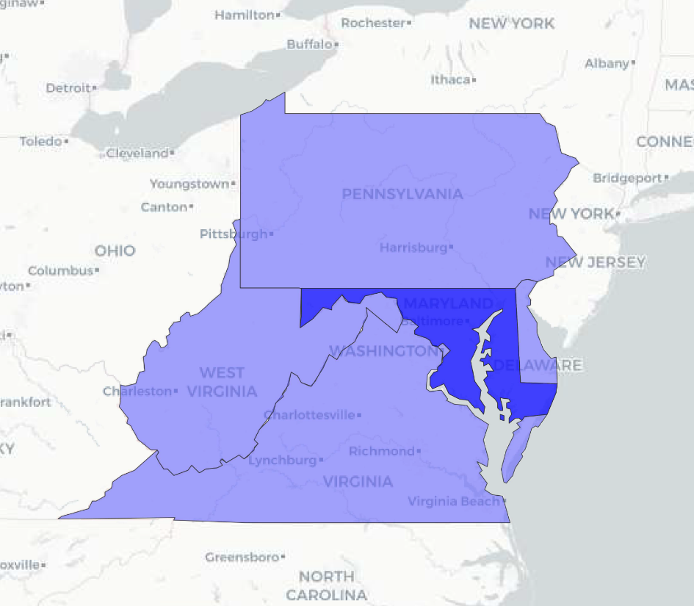
County-level Download Options: 51 state-centric files; factors for entire US

Slide 12
Other Bts freight data products with potential application to models

Slide 13
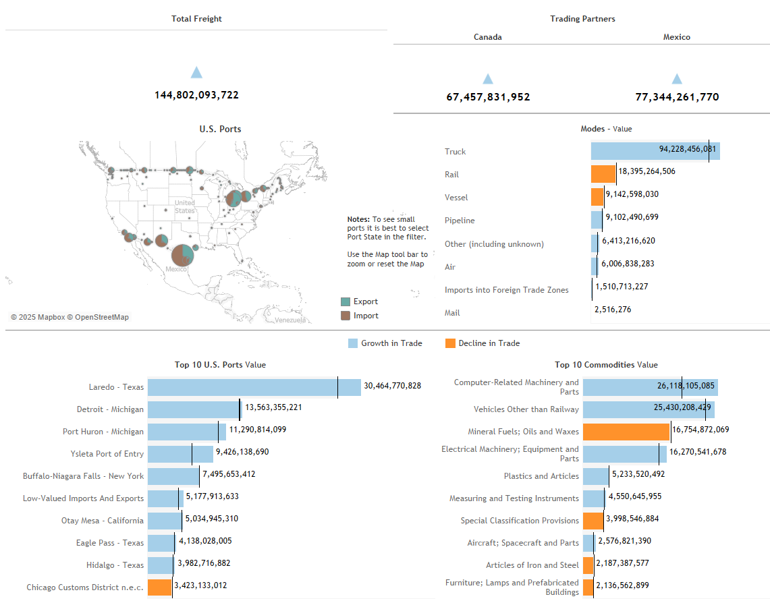
TransBorder data program: Measuring US-North American Freight
The TransBorder Freight program provides North American freight data by mode of transportation, commodity type, and geographic detail for U.S. exports to and imports from Canada and Mexico.
TransBorder Freight Data are the exclusive source of trade data by land mode of transportation. Users can obtain value and weight data for any combination of two of the following three variables: Port, Commodity, and State. The data are used for trade corridor studies, transportation infrastructure and border planning, marketing and logistics analyses, and other transportation research.
BTS publishes a monthly statistical release that highlights key trends and are often cited by popular trade publications and media outlets. The interactive data dashboards below allow users to visualize data by mode of transportation, commodity, and port of entry or exit. Data on U.S. cross border freight with Canada and Mexico that are collected as part of required import and export trade filings.
https://data.bts.gov/stories/s/kijm-95mr

Slide 14
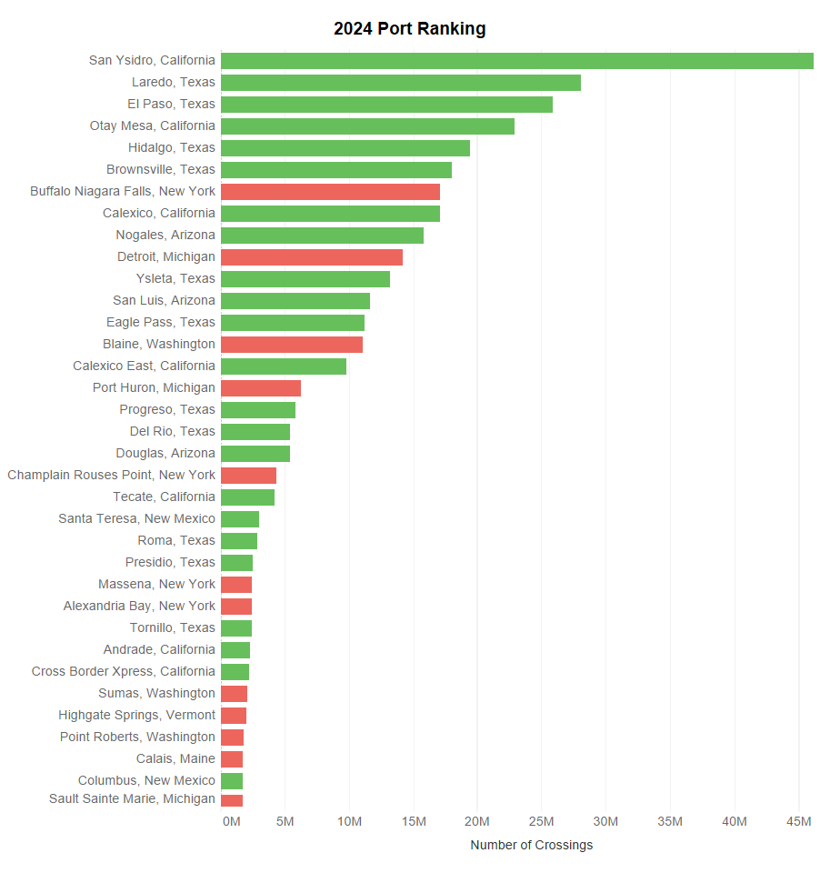
BorderCrossing Data Program
The BorderCrossing data program provide statistics for inbound land crossings at the US-Canada and the US-Mexico border ports of entry by mode of transportation, month, and year. The data reflect the number of vehicles, containers, passengers or pedestrians entering the US from Canada and Mexico.
Data are released monthly in both Socrata and Tableau formats including data visualizations such as charts, graphs, and maps.
Data source is the US Customs and Border Protection (CBP).
Stakeholders include local and State DOTs, researchers, consulting firms, and trade publications. FHWA and Congress uses border crossing data for apportionment funding.
https://data.bts.gov/stories/s/jswi-2e7b

Slide 15
T-100 Air Cargo
The T-100 program requires airlines to report monthly data to BTS’ Office of Airline Information (OAI) on the number of passengers and weight of air cargo and mail for each pair of airports served by the carrier.
Summary tons and ton-miles: https://www.transtats.bts.gov/freight.asp

Slide 16

BTS Freight Mobility Initiative
Projects using aggregated, anonymized, non-customer-specific truck probe GPS position data covering the entire United States
American Transportation Research Institute (ATRI)
Database elements:
Fields: Latitude, Longitude, Date-Time, Speed, Heading, Unique/anonymized truck identifier
Length: 434 billion rows
Dates: 1 October 2018 to 30 June 2025
Areas: Continental US, Alaska, Hawaii, Puerto Rico, Canada, 5 miles into Mexico
Stored on secure, BTS-hosted Databricks site
Access requirements:
Users must use secure data platform, sign program data-sharing agreement
Users must be a select USDOT, federal statistical agency employees
Projects cannot reveal individual businesses’ operations
Cannot be used for regulatory or law enforcement purposes
Public FMI website,
first product
launched in August 2025
Notes:
Restrictions apply to how the FMI data can be used:
Cannot be used for any federal policy initiative whose stated purpose would clearly and directly negatively affect the rights, privileges, or benefits of an identifiable industry
Must be used by a federal government employee or his or her designated contractors
Must be used for specific uses; it cannot be used for open-ended storage and use

Slide 17
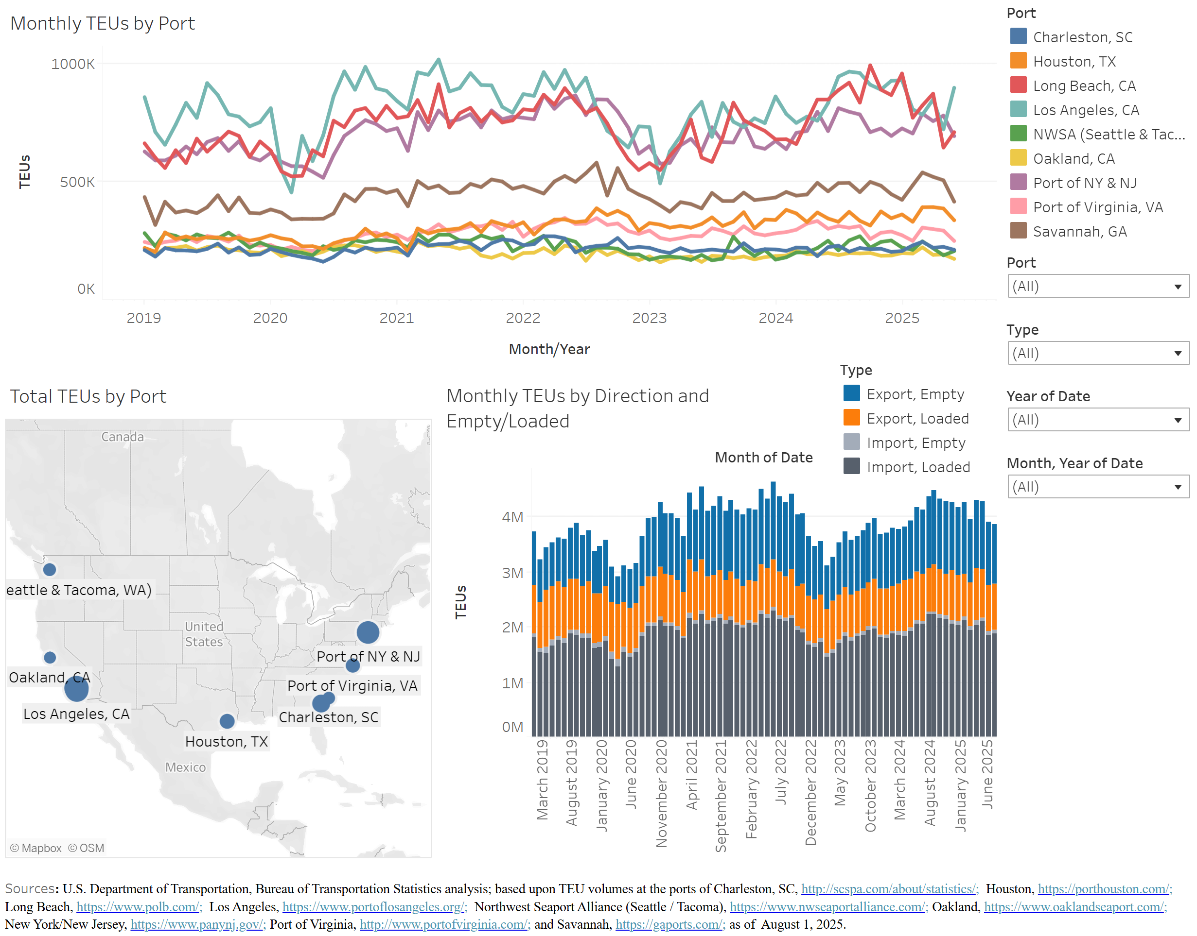
Port Performance Freight Statistics Program
Purpose: Provide nationally consistent performance measures on capacity and throughput for the Nation’s largest tonnage, container, and dry bulk ports
Annual Report to Congress
11 dashboards including Port Profiles, Vessel Dwell Time at Berth, and more
Port-related Data Spotlight Articles
https://www.bts.gov/ports

Slide 18

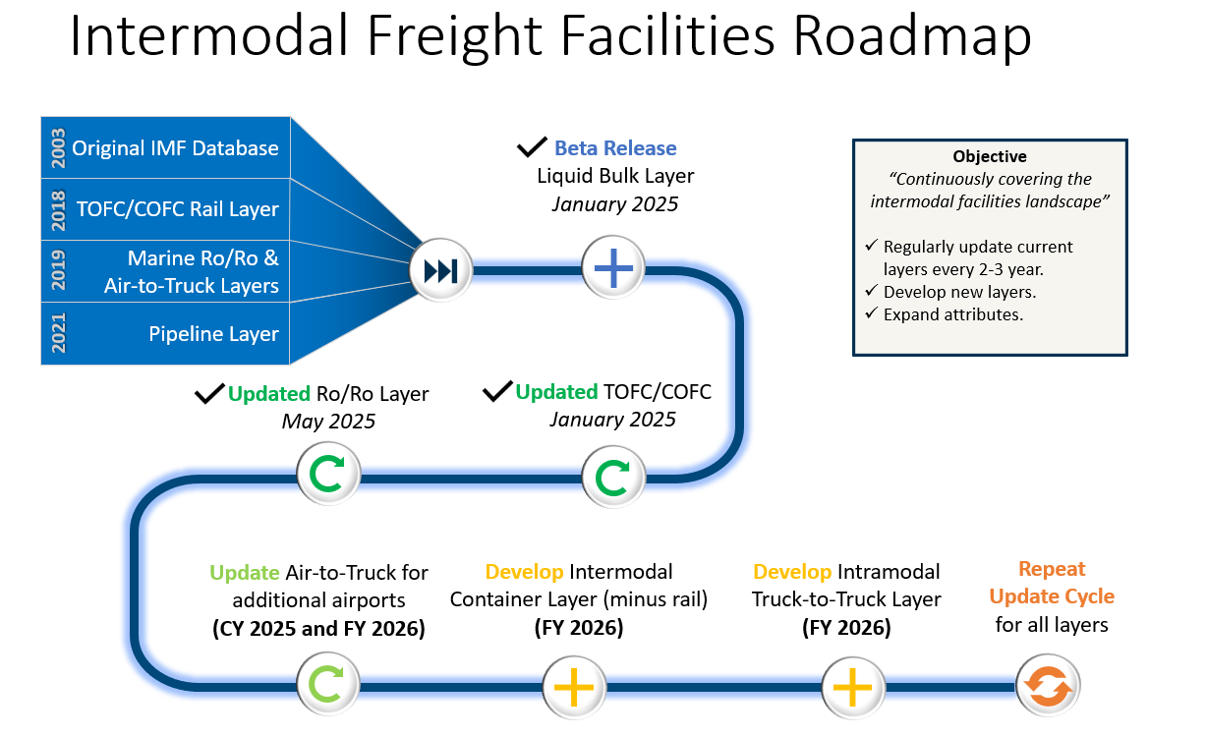
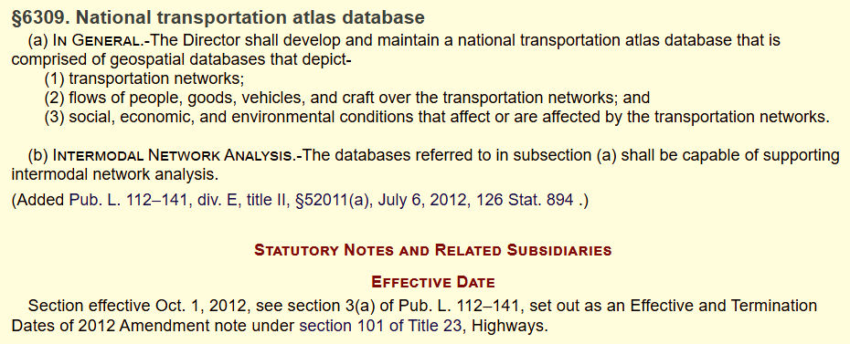
National Transportation Atlas Database (NTAD)
Legislatively mandated by Congress
NTAD comprises 120+ geospatial datasets hosted on ArcGIS Online (AGOL)
These data support research, analysis, and decision-making across all modes of transportation
The datasets are primarily national in scale, but have major applications at regional, state, and local scales throughout the transportation community
Contains 5 intermodal freight facility databases
Production and potential updates:
https://geodata.bts.gov/

Slide 19
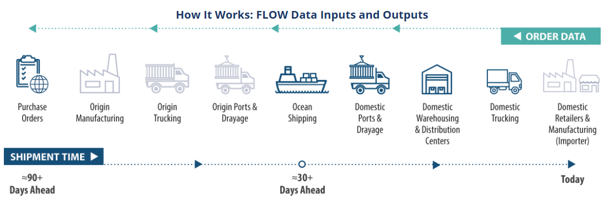
FLOW: Freight Logistics Optimization Works
The FLOW program is a community of supply chain stakeholders that share individual logistics data with the U.S. Department of Transportation and in return receive an aggregate, anonymous, and holistic view of the relationship between incoming containers (demand) and the available assets to move containers (supply) at a given supply chain node.
The program is voluntary, and data shared with FLOW is secure, subject to the Confidential Information Protection and Statistical Efficiency Act (CIPSEA) and analyzed by the Bureau of Transportation Statistics.
FLOW is currently scoped for containerized import freight ​
Eligible participants include shippers and logistics service providers
Nearly 90 U.S. stakeholder participants
https://www.bts.gov/flow

Slide 20
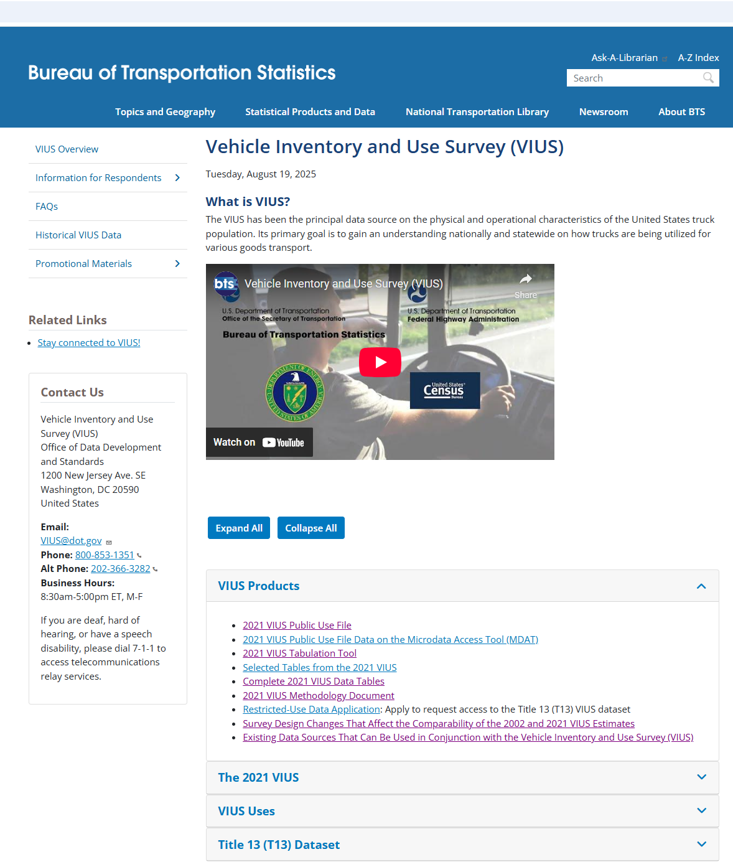
Vehicle Inventory and Use Survey (VIUS)
The principal data source on the physical and operational characteristics of the truck population in the U.S.
2021 VIUS surveyed 150,000 owners of trucks with GVWR classes 1-8; collected information on vehicle body type, safety and technology features, fuel type, VMT, use type, product carried, etc.
VIUS data are used in informing transportation infrastructure investment decisions, freight demand modeling, air quality modeling, safety analysis, estimating energy consumption, and understanding the role of trucks in economy
VIUS Data Products
Data Tables: aggregate data on number of vehicles, VMT, and average miles per vehicle for the entire U.S. (or by state) by different variables (e.g., vehicle type, body type, GVWR, model year)
Public Use File: disaggregate (i.e., vehicle-level) data
Data Tabulation Tool: cross tabulation of vehicle counts by up to two variables (for entire U.S. and by state), and tabulation of miles per gallon by one variable
https://www.bts.gov/vius

Slide 21
Supply Chain Indicators
BTS leads an Interagency Working Group which provides metrics on the supply chain
46 graphs covering:
Port data inside the gate
Port data outside the gate
Freight movement
Labor capacity and tightness
https://www.bts.gov/freight-indicators

Slide 22
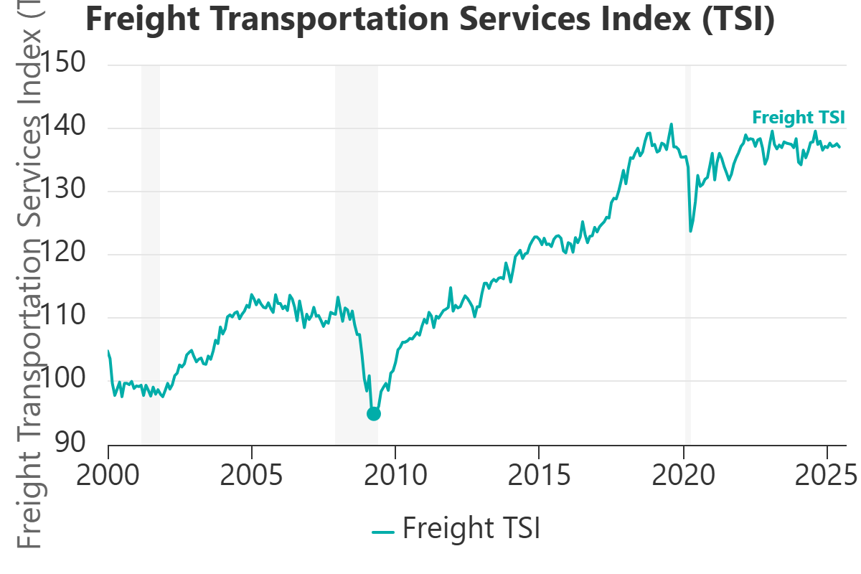
Freight Transportation Services Index (TSI)
Freight TSI is a monthly measure of the output of the domestic for hire freight transportation industry
It is based on ton miles (where available, proxies such as tonnage or rail carloads where ton miles are not available) shipped by rail, truck, inland water, pipeline and air freight
Each series is indexed, seasonally adjusted, and weighted based on value-added (the difference between an industry’s revenues and input costs, which sums to GDP across industries)
Freight TSI has led the business cycle/growth cycle
https://data.bts.gov/stories/s/Transportation-as-an-Economic-Indicator/9czv-tjte

Slide 23
Transportation Satellite Accounts (TSA)
Transportation (of Passengers and Freight*) Contributed $1.8 Trillion (6.5%) to the U.S. Economy in 2023
Wholesale and Retail Trade Required More Transportation Per Dollar of Output Than Any Other Industry in 2023
For-hire: $51.70; In-house $0.15
For-hire: $22.0; In-house $3.7
*Truck is all freight (other, air, rail, and water include both passenger and freight)
https://www.bts.gov/satellite-accounts

Slide 24

Freight Facts and Figures
Provides a snapshot of
freight movement;
the extent, condition, and performance of the freight transportation system;
the economic characteristics of the transportation industry and its contribution to the U.S. economy; and
the safety and energy aspects of freight transportation
https://www.bts.gov/product/freight-facts-and-figures

Slide 25
Transportation Statistics Annual Report: Freight chapter
Efficient U.S. freight transportation is essential to the country’s economic strength, directly impacting industries’ abilities to access materials, ship products, and manage logistics operations.
2024 Highlights:
The U.S. freight system accommodated around 5,465 billion ton-miles in 2023, with trucking dominating short-haul distances below 100 miles;
Emerging issues for the freight sector include concerns over potential overcapacity in the liner shipping industry, ongoing vessel diversions around the Suez Canal;
https://www.bts.gov/tsar

